Slide 1
Chapter 3
Regular Expressions (R.E.)

Slide 2
Outline
Defining Regular expression
Building Regular Expressions
Examining the algebraic laws applied to Regular Expressions

Slide 3
What is Regular Expression (R.E.)
Regular expression : is another language-defining notation
Regular expression (R.E.) is an syntactic or algebraic description of a language.
Regular expression defines ,Regular languages, exactly the same languages that defined by the various form of automata.
E.g., 01* Offers a declarative way to express the pattern of any string we want to accept
Regular expressions are closely related to NFA.

Slide 4
Regular Expressions vs. Finite Automata
Regular expressions
=
Finite Automata (DFA, NFA, ε-NFA)
Syntactical expressions
Automata/machines
Regular Languages
Formal language classes

Slide 5
Operator of R. E.
Three Operations on languages that R.E. represent.
Union of two languages:
L U M = all strings that are either in L or M
e.g., L = {001, 10, 111 }, M = {∊, 001},
L ⋃ M = {∊ ,001, 10, 111 }
Concatenation ( dot ) of two languages
L . M = all strings that are of the form x y
s.t., x ∈ L and y ∈ M
L.M= {001,10, 111 , 001001, 10001, 111001 }

Slide 6
Operator of Reg Ex
“i” here refers to how many strings to concatenate from the parent language L to produce strings in the language L^{i}
Kleene Closure (the star * operator)
L⁰= {ε}
L¹= {w | for some w ∈ L}
L²= { w₁w₂ | w₁ ∈ L, w₂ ∈ L (duplicates allowed)}
L^{i}= { w₁w₂…w_{i} | all w’s chosen are ∈ L (duplicates allowed)}
Note: the choice of each w_{i} is independent)

Slide 7
Operator of R. E.
Example:
Let L = { 1, 00}
L⁰= {ε}
L¹= {1,00}
L²= {11,100,001,0000}
L³={111,1100,1001,10000,000000,00001,00100,0011}

Slide 8
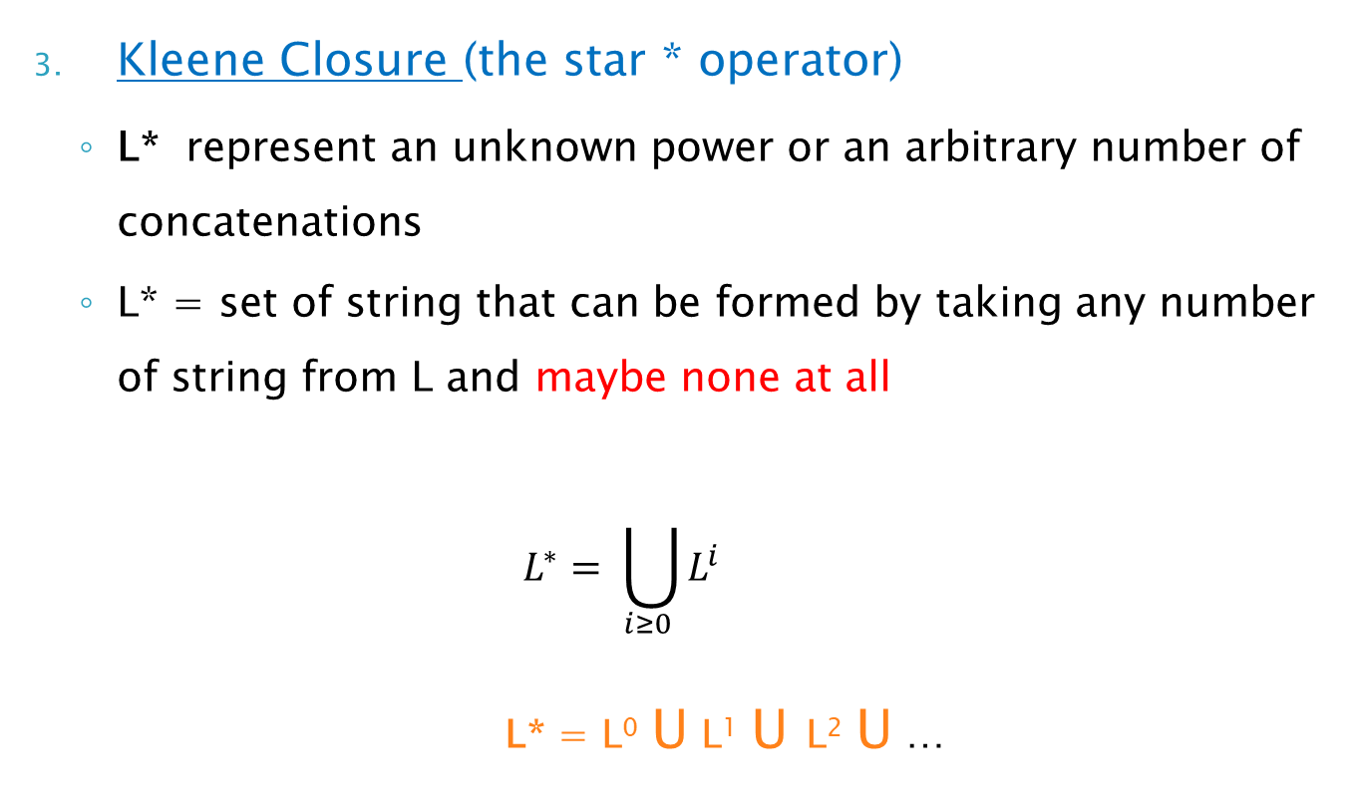
Operator of R.E.
Kleene Closure (the star * operator)
L* represent an unknown power or an arbitrary number of concatenations
L* = set of string that can be formed by taking any number of string from L and maybe none at all
$$L^{∗}= \bigcup_{i≥0 }{L^{i}}$$
L* = L⁰ U L¹ U L² U …

Slide 9
Kleene Closure (special notes)
L* is an infinite set iff |L|≥1 and L≠{ε}
Closure is finite set for two cases :
If L={ε}, then L* = {ε}
If L = Φ, then L* = {ε}
Σ* denotes the set of all words over an alphabet Σ
Therefore, an abbreviated way of saying there is an arbitrary language L over an alphabet Σ is:
L ⊆ Σ*

Slide 10
Building Regular Expressions
Applying algebra operations on elementary expression ( constants and variables ) to construct more expressions.
Operations :
* (star)
. (dot , or concatenation)
+ (Union)
If E is a R.E. and L(E) is the language represented by E

Slide 11
Building Regular Expressions
Constants ∊ and ∅ are R.E. denoting the languages {∊} and ∅
L(∊) = {∊} , and L(∅ ) = ∅
If a is a symbol then a is R. E. denote language {a}
L(a) = {a}
Variable usually CAPITALIZED and italic such as L

Slide 12
Building Regular Expressions
Four Inductive steps of R.E. E and F
L(E + F) = L(E) U L(F) union
L(E F) = L(E) L(F) Concatenation
L(E*) = (L(E))* Closure
(E) = E Parenthesized

Slide 13
Building Regular Expressions
Suppose a language over the alphabet = { 0, 1}
0 is R.E. Elementary symbol
1 is R.E. Elementary symbol
01 is R.E. Concatenation
0 + 1 is a R.E. Union
(01) is R. E. Parenthesized
(01)* is R. E. Closure note 01* is differ

Slide 14
Example:
Write a regular expression for a language L such that
L = { w | w is a binary string which starts with 1s anywhere
E.g., w = 1, 10, 11, are in L, while w = 0, 010 are not in L.
R.E. for L = 1(0+1)*
L = { w | w is a binary string which sends with 1s anywhere
E.g., w = 1, 01, 11, are in L, while w = 0, 010 are not in L.
R.E. for L = (0+1)* 1

Slide 15
Example:
Write a regular expression for a language L such that
L = { w | w is a binary string which does not contain two consecutive 0s or two consecutive 1s anywhere)
E.g., w = 01010101 is in L, while w = 10010 is not in L.
Goal: Build a regular expression for L
Four cases for w:
Case A: w starts with 0 and |w| is even
Case B: w starts with 1 and |w| is even
Case C: w starts with 0 and |w| is odd
Case D: w starts with 1 and |w| is odd

Slide 16
Example: cont.
Regular expression for the four cases:
Case A: (01)*
Case B: (10)*
Case C: 0(10)*
Case D: 1(01)*
Since L is the union of all 4 cases:
R.E. for L = (01)* + (10)* + 0(10)* + 1(01)*

Slide 17
Example: cont.
Another way to write the R.E.
Start with (01)*
add optional 1 to the left by (ε + 1) (01)*
ε gives all choice of (01)*
1 give all choice of 1w, for every string w
add optional 0 to the right by (01)* (ε + 0)
R.E. = (ε +1)(01)*(ε +0)
another regular expression of set of string contains alternating 0;s and 1’s

Slide 18
Precedence of Operators
Highest to lowest
* (star operator)
. (concatenation or dot operator)
+ (union operator)
Example:
01* + 1 = ( 0 . ((1)*) ) + 1

Slide 19
Examples:
Give a regular expression for the following languages
{w ∈ {0, 1}* : w has 001 as a substring}.
{ w ∈ {a, b}* : w starts and end with b.
{w ∈ {a, b}* : w has bba as a substring}.
(0 + 1)*
001
(0 + 1)*
(b)
(a + b)*
(b)
(a + b)*
bba
(a + b)*

Slide 20
Examples:
The set of strings of 0’s and 1’s whose tenth symbol from the right end is 1
(0 + 1)*
1
(0+ 1)⁹
All strings that do not end with aa
ε + a+ b +
(a + b)*
(ab +ba+ bb)
{w ∈ {a, b}* : w does not end in ba}.
ε + a +
(a + b)*
(b
+ aa)

Slide 21
Examples:
{w ∈ {a, b}* : every a in w is immediately preceded and followed by b}.
(
b +
bab
)*
{w ∈ {a, b}* : w has both aa and bb as substrings}.
(a + b)* aa (a + b)* bb (a + b)* +
(a +b)* bb (a + b)* aa (a+b)*

Slide 22
Exercises
The set of strings over alphabet {a, b, c} containing at least one a and at least one b.
{w ∈ {0, 1}* : w does not have 001 as a substring}.
{w ∈ {0, 1}* : w with at most one pair of consecutive 1’s.

